Slide 1
The Battle of Neighbourhoods
Capstone Project
IBM DATA SCIENCE PROFESSIONAL CERTIFICATE

Slide 2
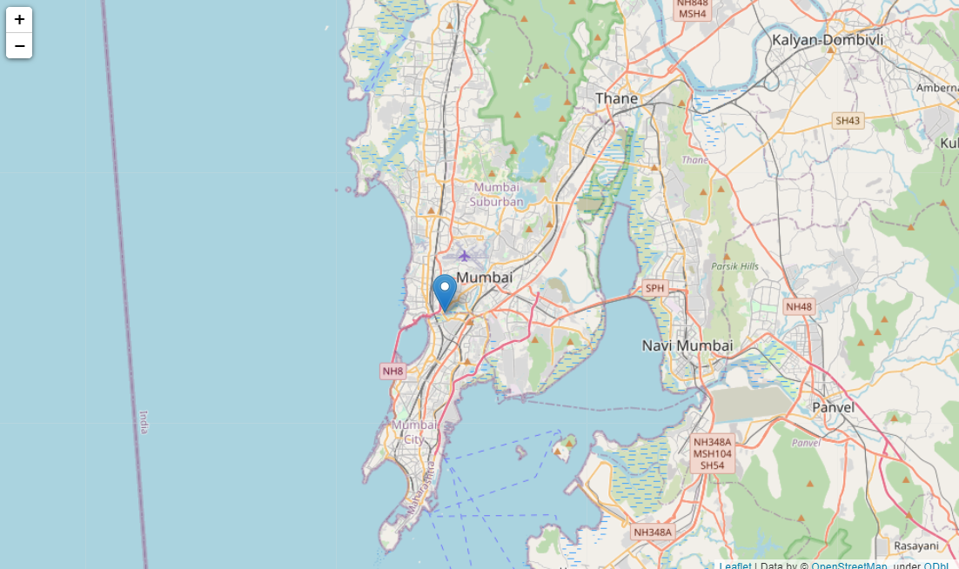
The problem statement for this project is to leverage the Foursquare data and find recommendations for a one day stay in the city

Slide 3


Data Sources: 1. Foursquare 2. Zomato

Slide 4
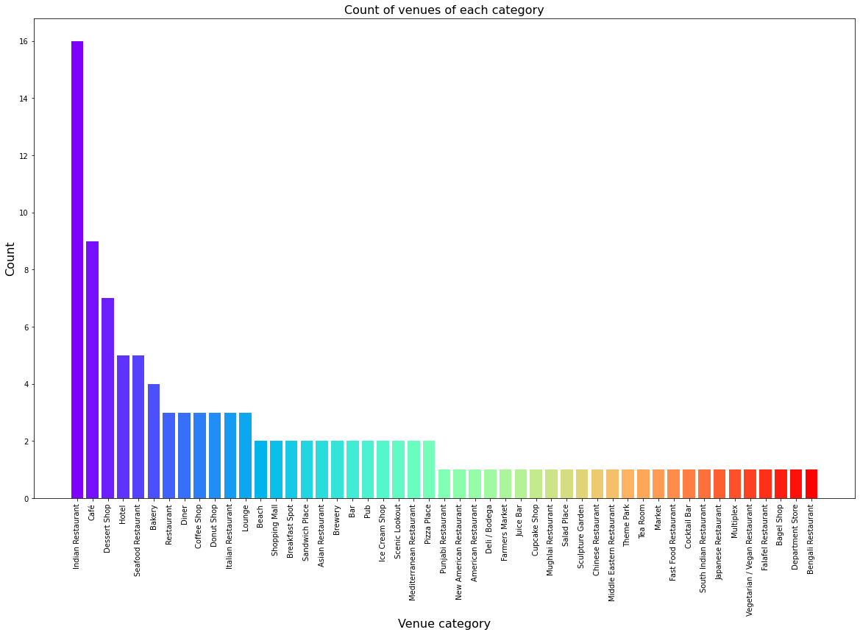
Exploratory Analysis Type of venues

Slide 5
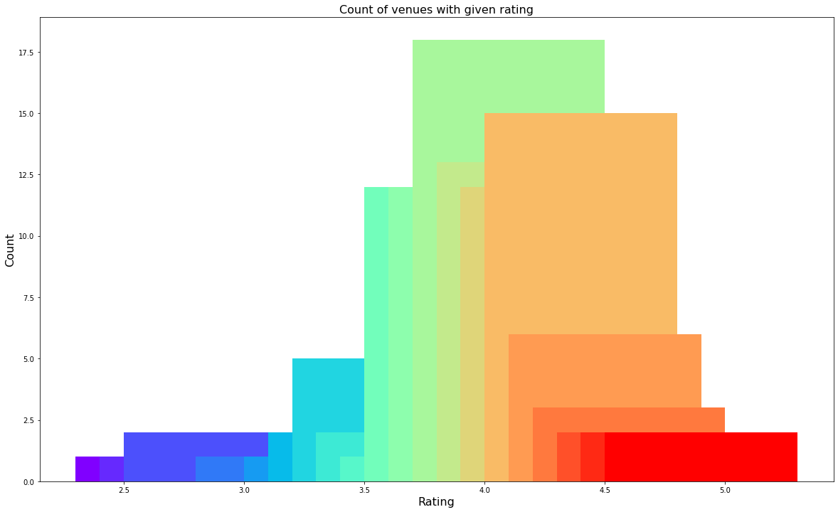
Exploratory Analysis Rating of venues

Slide 6
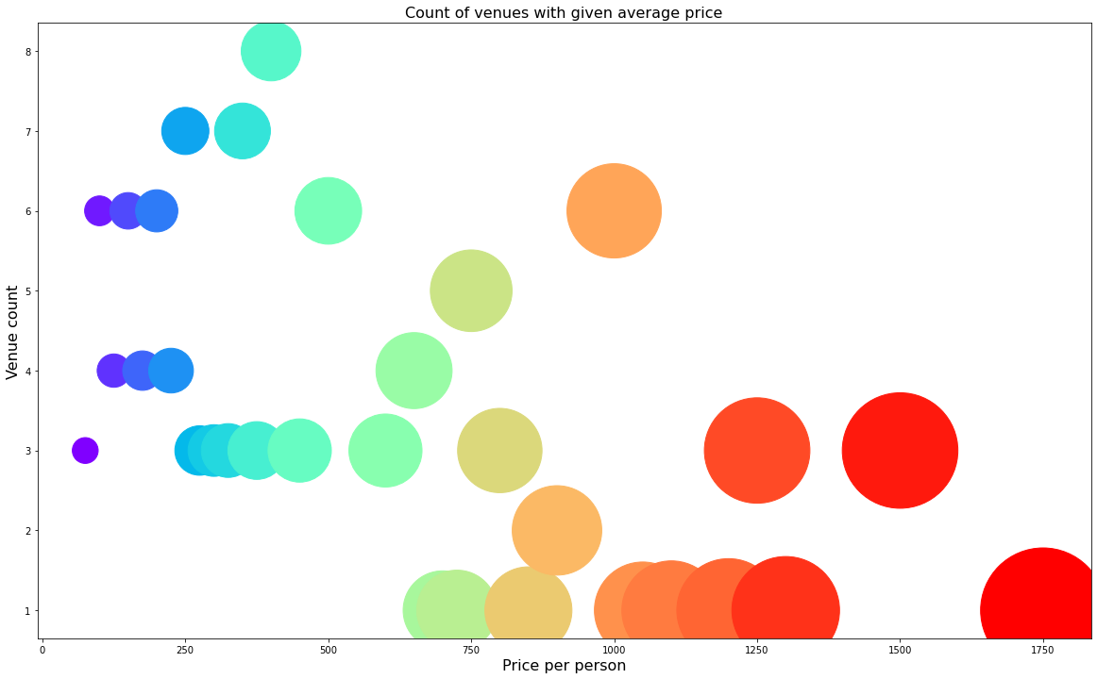
Exploratory Analysis Price of venues

Slide 7
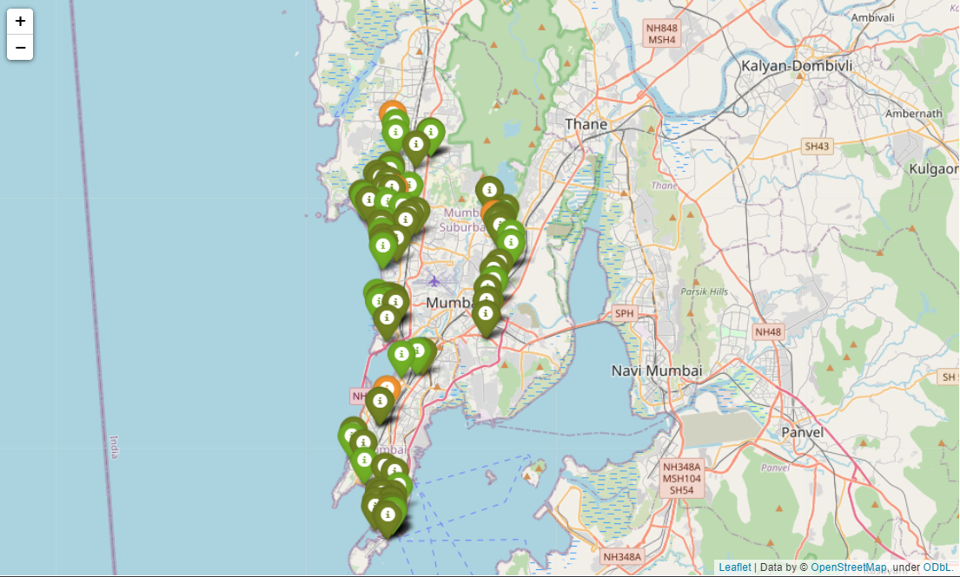
Venues on the basis of ratings

Slide 8
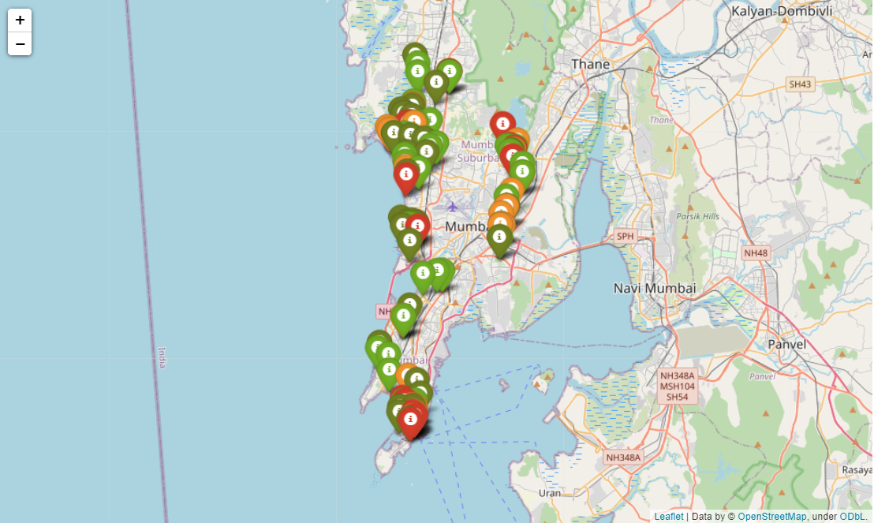
Venues on the basis of prices

Slide 9
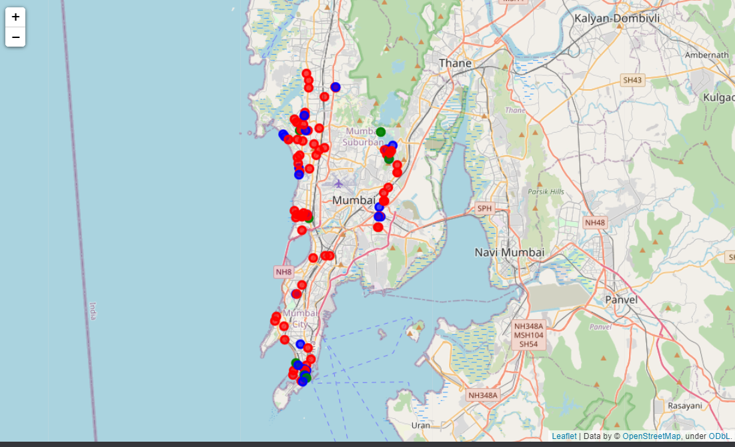
Clustering A On the basis of rating and price

Slide 10
Clustering A results:
This clustering gives us three kinds of clusters.
Expensive venues with good rating (4.21)
Cheap venues with decent rating (4.04)
Moderately priced with excellent rating (4.27)

Slide 11
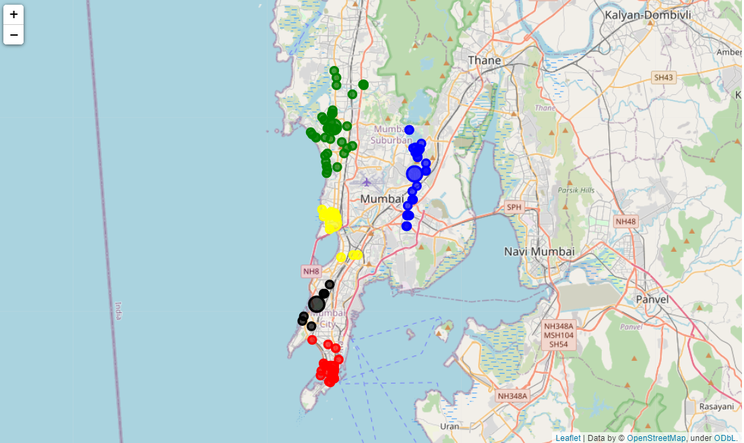
Clustering B On the basis of location

Slide 12
Clustering B results
These areas are colour coded in the map below.
1. Green- Juhu-Versova
2. Blue- Powai-Ghatkopar
3. Yellow- Bandra
4. Black- Parel
5. Red- Colaba

Slide 13
Conclusions:
We identified that from the total set of venues, majority of them were Cafes and Indian Restaurants.
While the complete range of ratings range from 1 to 5, the majority venues have ratings close to 4.
This means that most restaurants provide good quality food and service which is liked by the people
of the city and the tourists, thus indicating the high rating.
When we take a look at the price values of each venue, we explore that many venues have prices
which are in the range of Rs 250 to Rs 1000 for one person. This also indicates the popular fact that
the financial capital of India is indeed an expensive place. However, there are plenty of choices for
cheaper venues as well. This is good thing as we have an option for every demand.
Through the first clustering we identified that there are few venues which are high rated (4.21) and
have a high price as well. These belong to the Zeroth cluster. Then there are many venues which are
low priced and have average rating of 4.04. These belong to the First cluster. The Second cluster has
limited venues which are moderately priced and are very high rated(4.27).

Slide 14
Thank you!

